Slide 1

CONCEPTS OF PROGRAMMING LANGUAGES
12th Edition
Chapter 12
Support for Object-Oriented
Programming

Slide 2
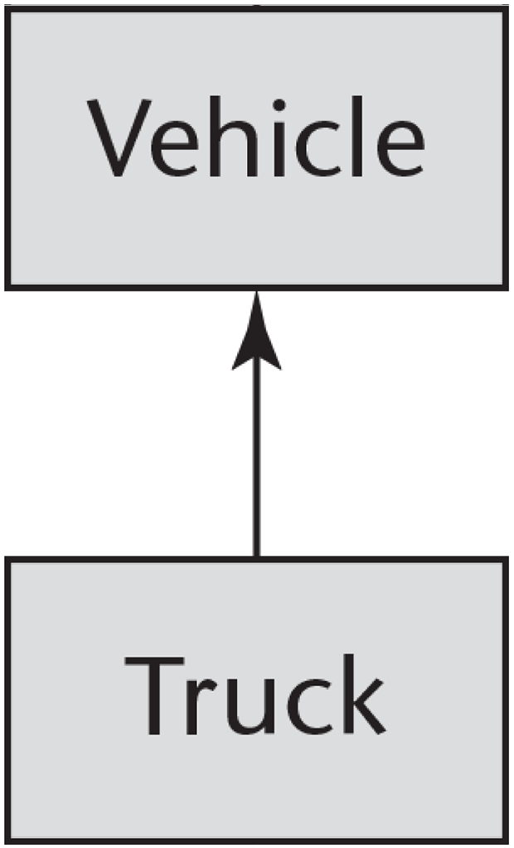
Figure 12-1 A simple example of inheritance

Slide 3
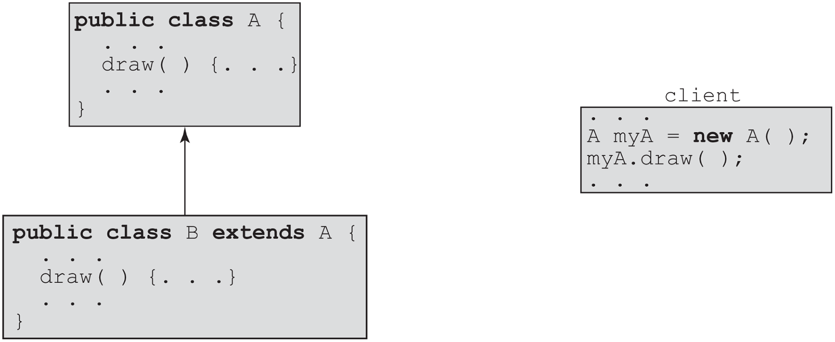
Figure 12-2 Dynamic binding

Slide 4
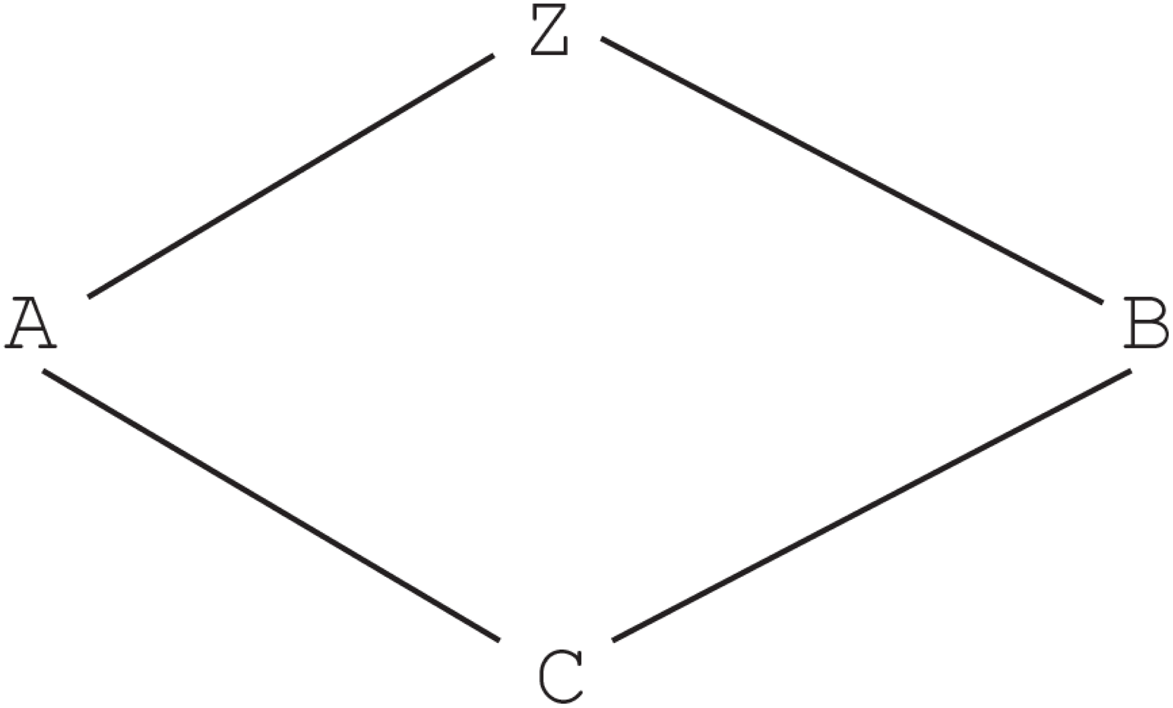
Figure 12-3 An example of diamond inheritance

Slide 5
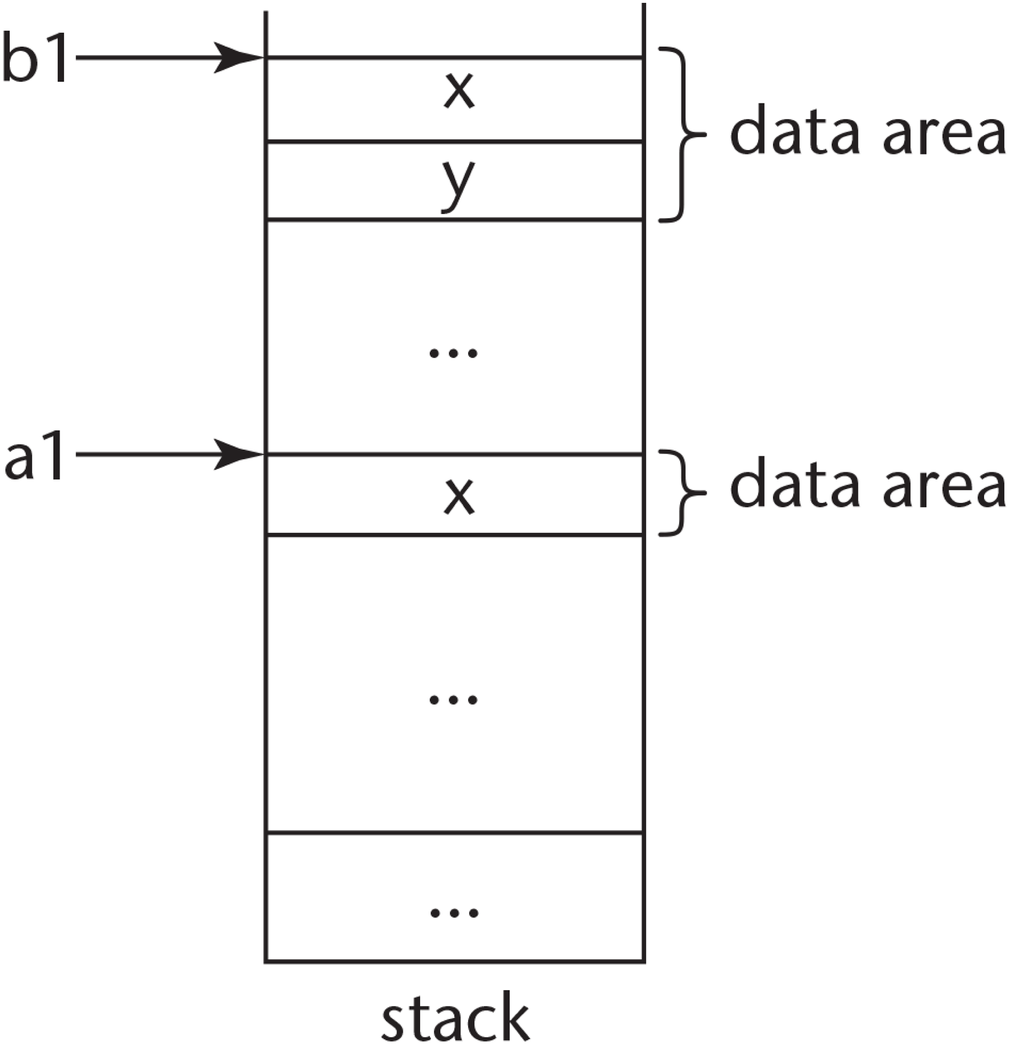
Figure 12-4 An example of object slicing

Slide 6
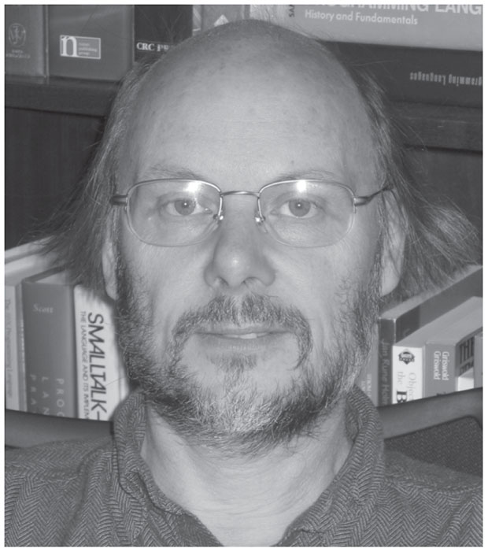
On Paradigms and Better Programming B J A R N E S T R O U S T R U P

Slide 7
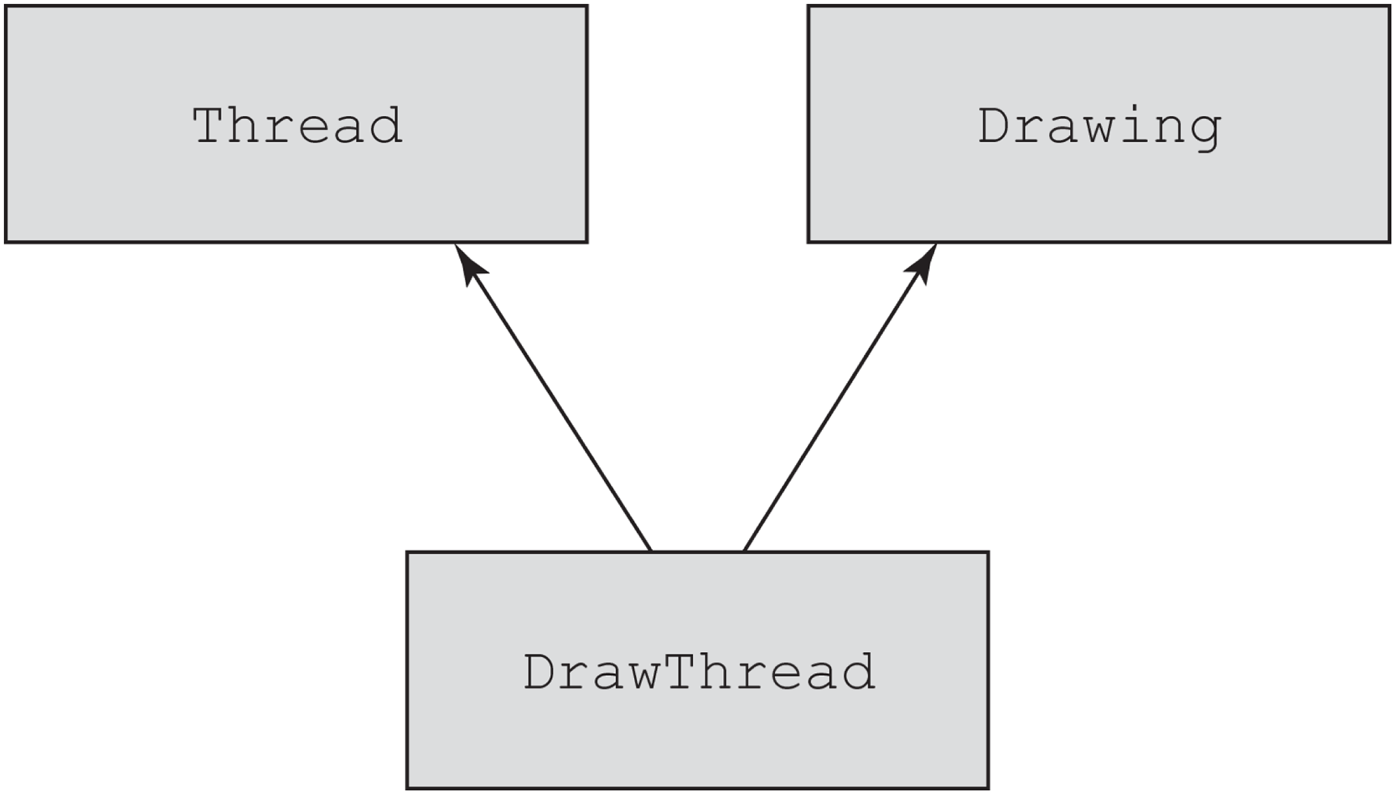
Figure 12-5 Multiple inheritance

Slide 8
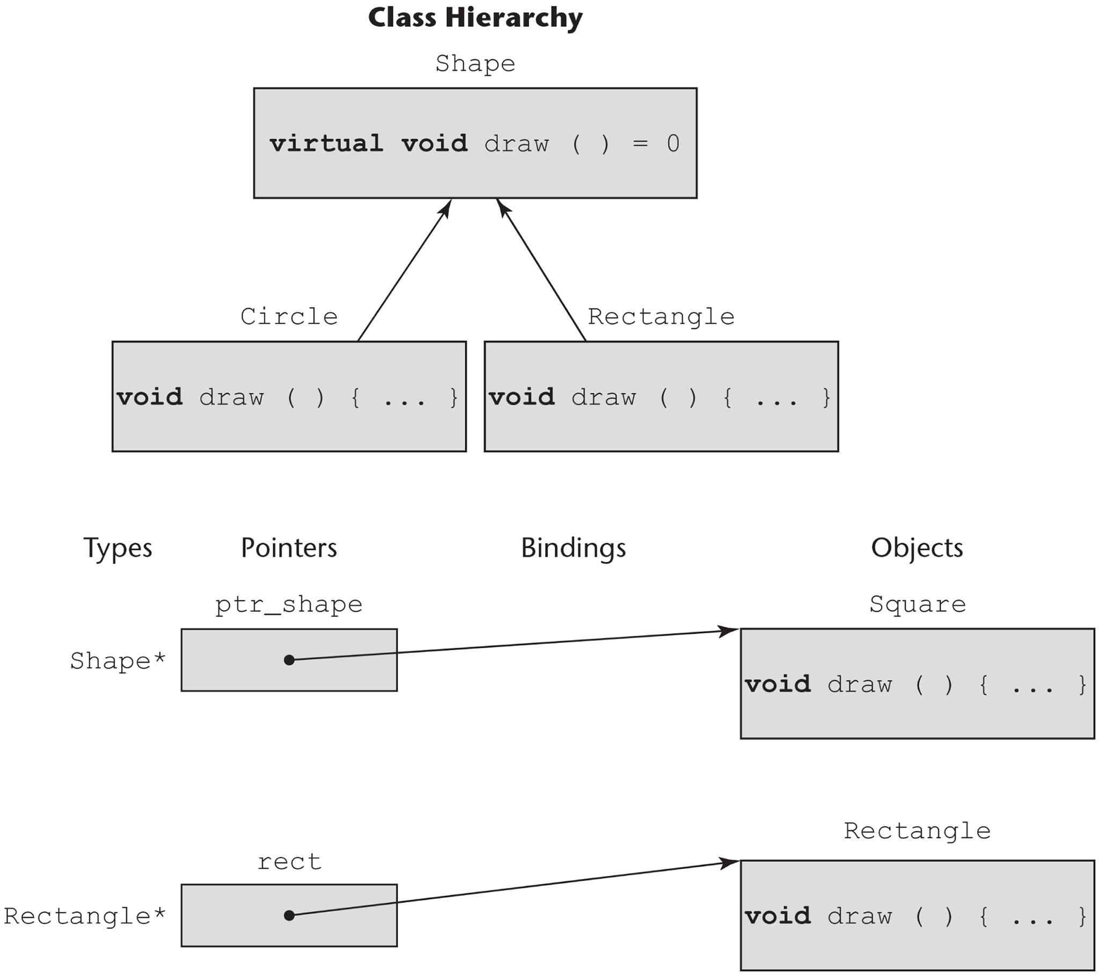
Figure 12-6 Dynamic binding

Slide 9
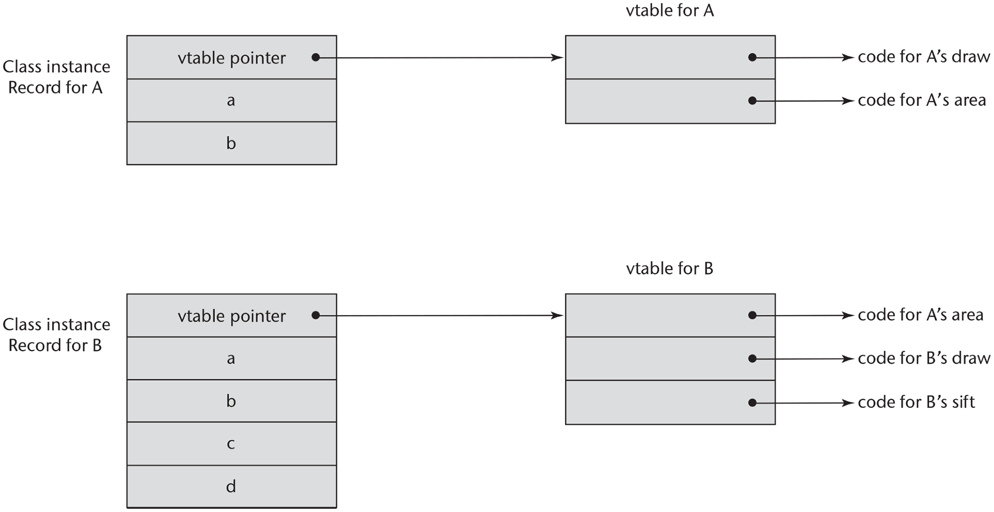
Figure 12-7 An example of the CIRs with single inheritance

Slide 10
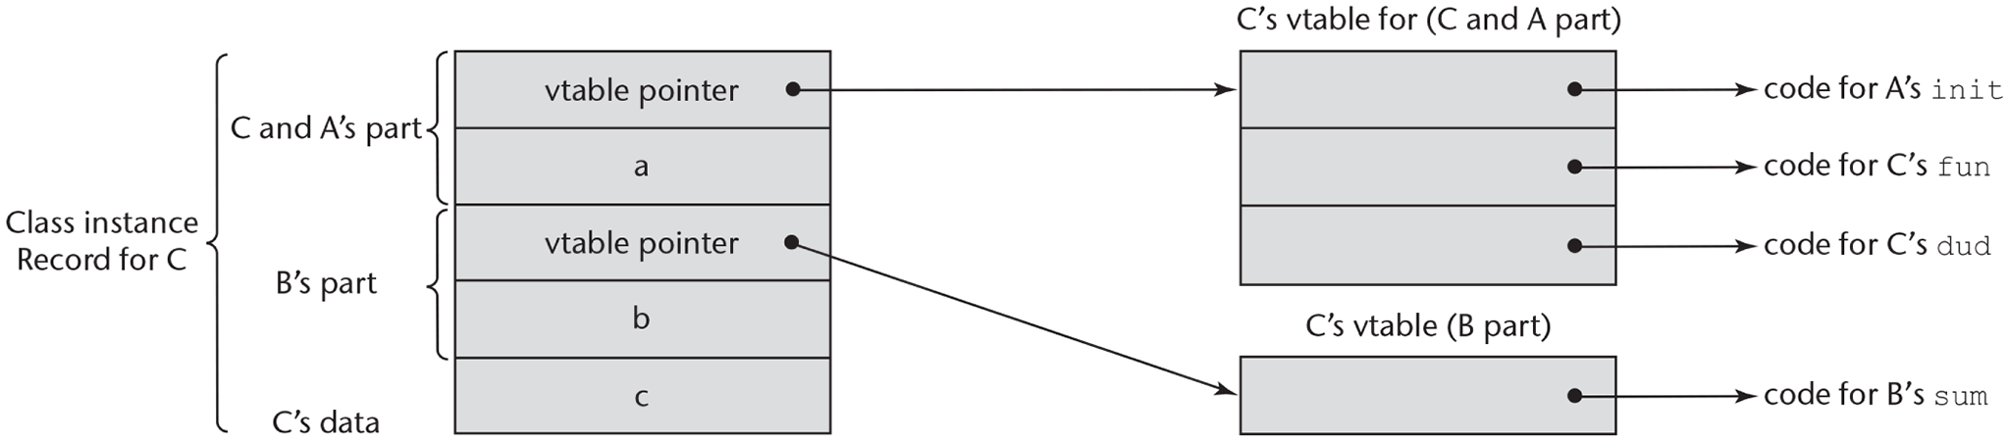
Figure 12-8 An example of a subclass CIR with multiple parents

